Slide 1
Using Text Classification as a Keyword Strategy for SEO
Ng Zeng Di
18 March 2023

Slide 2
Background
Trip.com Group wants to expand to the North America Market
Research long-tail keyword opportunities, target low-competition keywords with high conversion rates

Slide 3



Slide 5
Problem Statement
Do a Keyword research to uncover queries to target and the popularity of these queries.
We will be using supervised learning technique so we’ll need some labeled data to train our model.

Slide 6


Collect Data from Reddit
Target initial pull to be 5000 each from the subreddit

Slide 7

Data Cleaning and EDA
replace null values with '-’
noticed many '[removed]' in selftext
ensure no duplicate columns

Slide 8
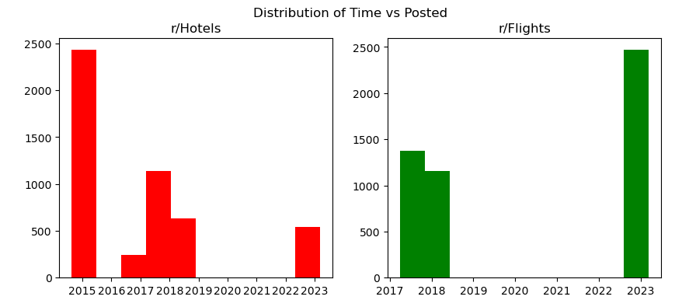
Number of posts
Number of posts
Year
possibility as due to Covid generally no data in 2020-2022

Slide 9
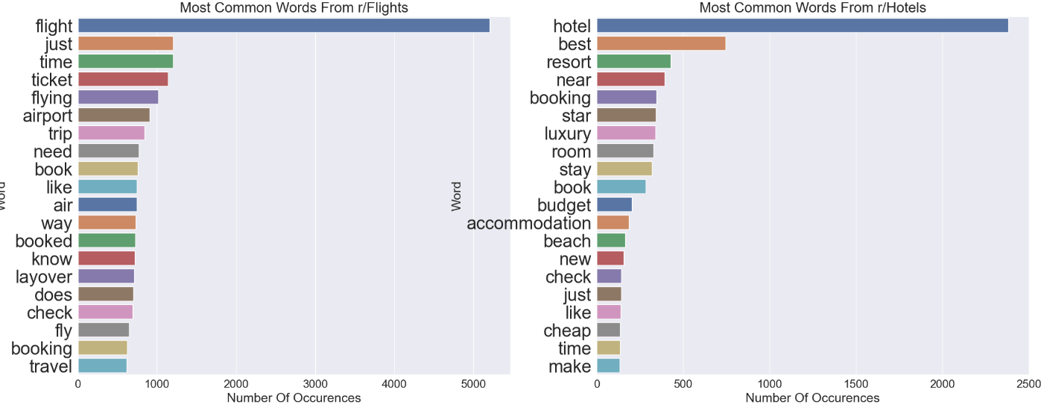

Slide 10
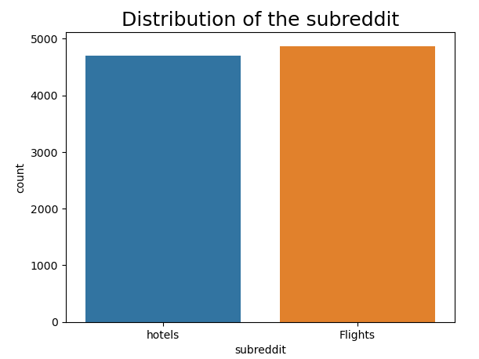

Slide 11
How Do You Measure the Effectiveness of a Text Classification Model in SEO?
This can be done through various metrics such as precision, recall, and F1 score.
A high precision indicates that the model is able to accurately identify the presence of the keyword in texts,
For example, in keyword classification, it may be more important to prioritize precision in order to minimize false positives and avoid targeting the wrong keywords.
Notes:
In order to measure the effectiveness of a text classification model in these applications, it is important to consider the specific goals and needs of the project

Slide 12
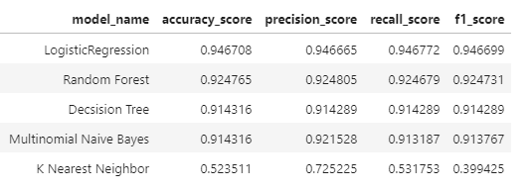
0.94 Precision and Recall score indicates model is good at identifying true positives while minimizing false positives and false negatives.

Slide 13
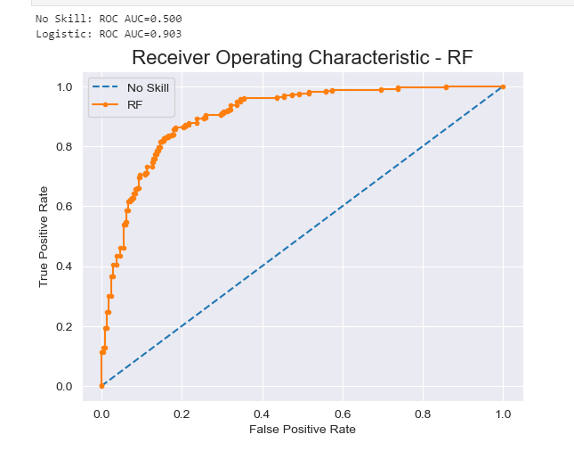
Fairly smooth curve, with an AUC of 0.903
High degree of accuracy in distinguishing between positive and negative examples

Slide 14
Conclusion
Logistic Regression was the best model, followed by random forest.
However, the training score (0.99) is higher than the testing score (0.925), indicating overfitting.
Ways to help:
Pull data from Quora as well to increase the training data
Use regularization like L2 or data augmentation techniques adding noise to the data.

